Slide 1
3. A grating has 5000 lines on 5 cm. On the diffraction pattern every 5th bright fringe is missing.
a. Determine the wavelength for which the angle between the two second order bright fringes is 10°!
b. Determine the width of the slits
c. Determine the coherence length of the light source if the 20th order bright fringes are visible, but the 21st order fringes are not!

Slide 2
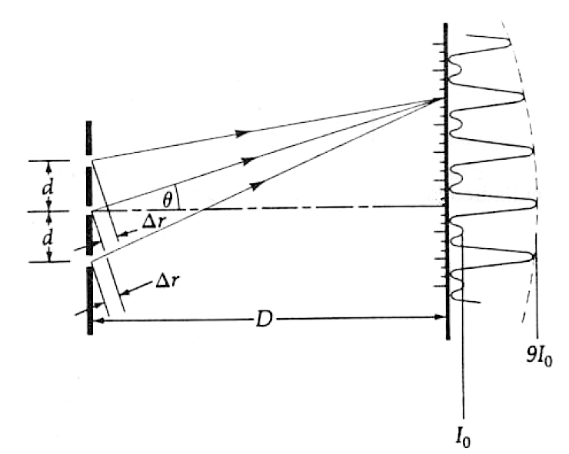
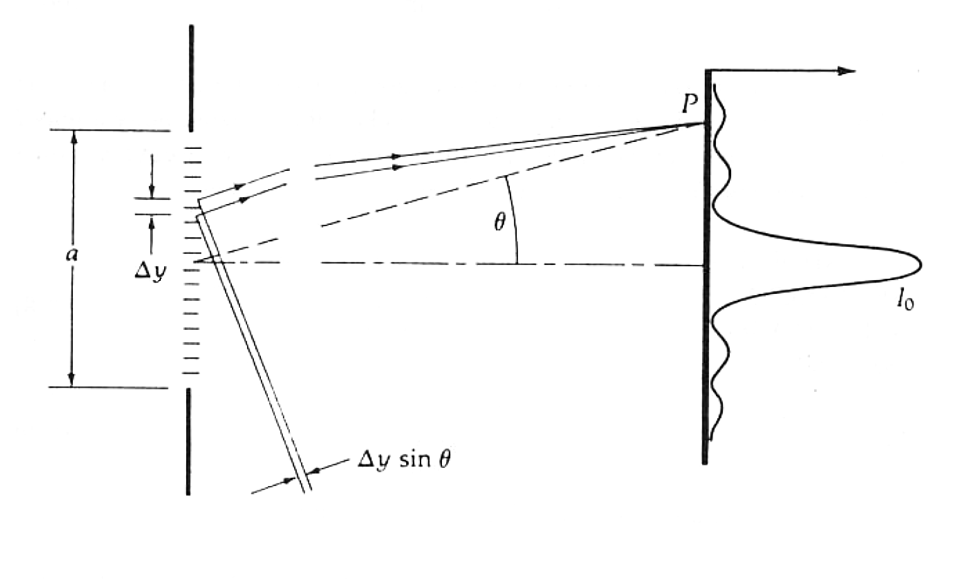


Bright: $mλ=d⋅\sin{θ}$
Dark: $kλ=a⋅\sin{θ}$

Slide 3








$m_{max}=20$
$N_{slit}=5000$
$d=\frac{w}{N_{slit}−1}=$ $\frac{5⋅{10}^{−2}}{5000−1}={10}^{−5}m$
$w=5cm=5⋅{10}^{−2}m$
$⇒θ_{m=2}=5°$
$θ_{m=2..m=−2}=10°$
$mλ=d⋅\sin{θ}$
$λ=\frac{d⋅\sin{θ}}{m}=\frac{{10}^{−5}⋅\sin{5°}}{2}=0.436⋅{10}^{−6}m=436nm$
Bright: $mλ=d⋅\sin{θ}$
$$\frac{m}{k}=\frac{d}{a} ⇒ a=d\frac{k}{m}=\frac{{10}^{−5}}{5}=2μm$$
Dark: $kλ=a⋅\sin{θ}$
$δ=m_{max}⋅λ=20⋅$ $436⋅{10}^{−9}=8.72⋅{10}^{−6}m=8.72μm$

